Slide 1
BLACK BOARD WRITING SKILL

Slide 2
Introduction of Black-board Writing
Blackboards, being the visual aids, are widely used in all aspects of education and training, and are most suitable for giving a holistic picture of the lesson. A good blackboard work brings clearness in perception and the concepts being taught, and adds variety to the lesson.

Slide 3
COMPONENTS OF BLACKBOARD WRITING
Size and Alignment [In A Straight Line]
Highlighting Main Points
Appropriateness
Neatness
Legibility ( Easy to Read )
Correctness
Pictorial Work

Slide 4
LEGIBILITY
A legible handwriting on the blackboard draws the attention of the learners and encourages them to improve upon their handwritings. In order to make handwritings more legible, the teacher should see that a clear distinction is ensured between every letter, adequate space is maintained between individual letters and words

Slide 5
Size and Alignment
The size of the letters written by the teacher on the board should be uniform and large enough to be read from the last row. The size of the capital letters should be larger than that of the small letters and the handwritings should be as vertical as possible without being diverged from a line.

Slide 6
Highlighting Main Points
The main points or words written on the board should only be highlighted by underlying them. Colored chalks should be used suitably for the purpose of drawing the learners attention to those main points that need to be highlighted too.

Slide 7
Blackboard Summary: In order to make teaching meaningful to the learners the teacher should develop blackboard summary at the end of the lesson. This should be so brief that the learners can recollect the whole lesson at a glance.
Correctness: While constructing sentences on the board, the teacher should be careful about correct spelling, punctuation, grammar, etc.

Slide 8
Correctness
While constructing sentences on the board, the teacher should be careful about correct spelling, punctuation, grammar, etc.

Slide 9
Position of the Teacher: The position of teacher should not be in between the learners and the blackboard.
Contact with Pupils: The teacher, at the time of writing on the board, should maintain eye-contact with his learners. This is necessary for controlling interactions, maintaining disciplines, sustaining attentions of the learners, etc.

Slide 10
Position of the Teacher:
The position of teacher should not be in between the learners and the blackboard

Slide 11
Legibility ( Easy to read ): A legible handwritin

Slide 13
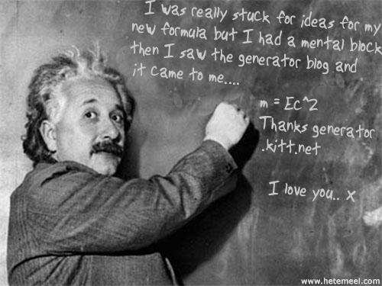
Conti.
Menu

